Slide 1
A Programmer: copies
Python Programming

Slide 2
Copy doesn't copy!!!
myList = [1,2,3]
copyList = myList
print(id(myList))
print(id(copyList))
print("oops!")

Slide 3
Slice might work
myList = [1,2,3]
copyList = myList[:]
print(id(myList))
print(id(copyList))
print("Better!")

Slide 4
Smaller Slice
myList = [1,2,3]
copyList = myList[start:end:step]
last = myList[-1]
reverse = myList[-1:0:-1]
print(reverse, "not all there!")
myList.reverse()
back = reversed(myList)

Slide 5
Deep Copy for nested collections
myList = [1,2,[a,b,c]]
copyList = myList[:]
# only does a "shallow" copy
from copy import deepcopy
copyList = deepcopy(myList)

Slide 6
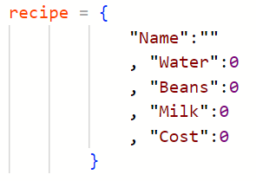
Dictionary Prototype

Slide 7
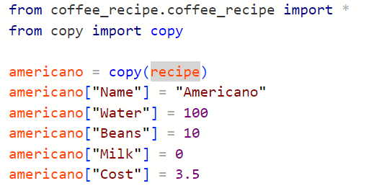
Copy Dictionary – a bit rubbish!

Slide 8
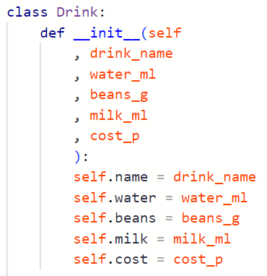
Write our own type

Slide 9

That's more like it!

